Slide 1

Order Attribution
Team Orange - Week 9

Slide 2



Executive summary
20.6%
when changing attribution models
Recommendation: Further analysis on how changing between multiple attribution models and its effects
Impact: Informed decision on attribution changes.
We are losing money on paid marketing cost per user
Recommendation: Reallocate the marketing budget to the unpaid and organic channels
Impact: Up to £4 saved per user on acquisition costs going forward.
Loss
Revenue by owned and not owned media follow the same trend but we are losing control
Recommendations:
Reallocation of marketing budget towards owned media, such as introducing pull email marketing
For long term, invest in owned media.
Impact: Reduce costs, increase profit
5.9﻿%

Slide 3

Has the investment in paid advertising been successful?
Notes:
1) paid unpaid
2) Attribution models, impact of changing this.
3 ) Paid vs owned.
Which one to invest in.

Slide 4



Paid vs Unpaid
Paid | Unpaid | Direct
affiliate | organic_social | (none)
cpc | crm
comparison | organic
cpm | referral
cpv
influencer

Slide 5

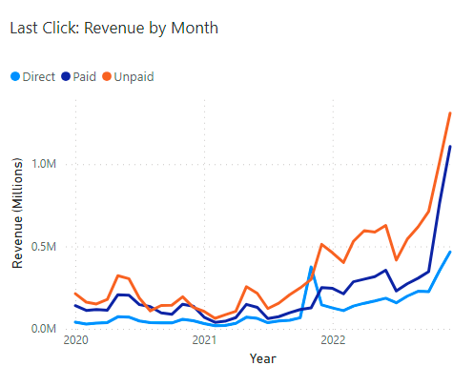
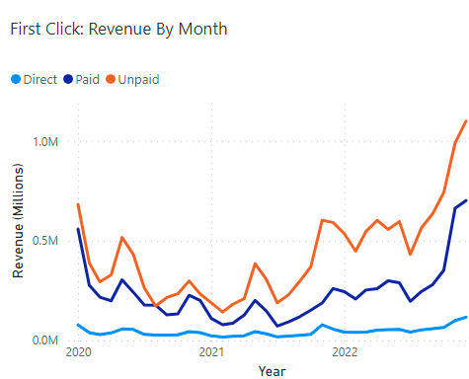
Changing attribution models leads to a 20.6% decrease in paid media revenue
Moving from last-click to first-click has shown a 20.6% decrease in revenue for paid medium
Recommendation: Further analysis must be done on changing between multiple attribution models and its effects
Notes:
Current: Last-Click.
Definiton: Attributing 100% to the touchpoint the customer last clicked on (found by joining transactions and sessions tables)
Limitations: Ignores other touchpoints before, in our case when customers viewed items and came back to buy later. View item events may have influenced a user's decision.
Compare: First-Click
Definition: gives 100% credit of a sale to the first touchpoint. Useful when wanting to track the effectiveness of your marketing campaigns
Limitation: Ignores the rest of the customer journey
3 takeaways from graphs
1. Increasing marketing spend leads to increase revenue across the board. this is expected
2. In the absence of increased paid marketting spend we could expect unpaid and direct to grow at a flatter rate so the increase definitely had a positive effect.
3. 20.6% decrease

Slide 6
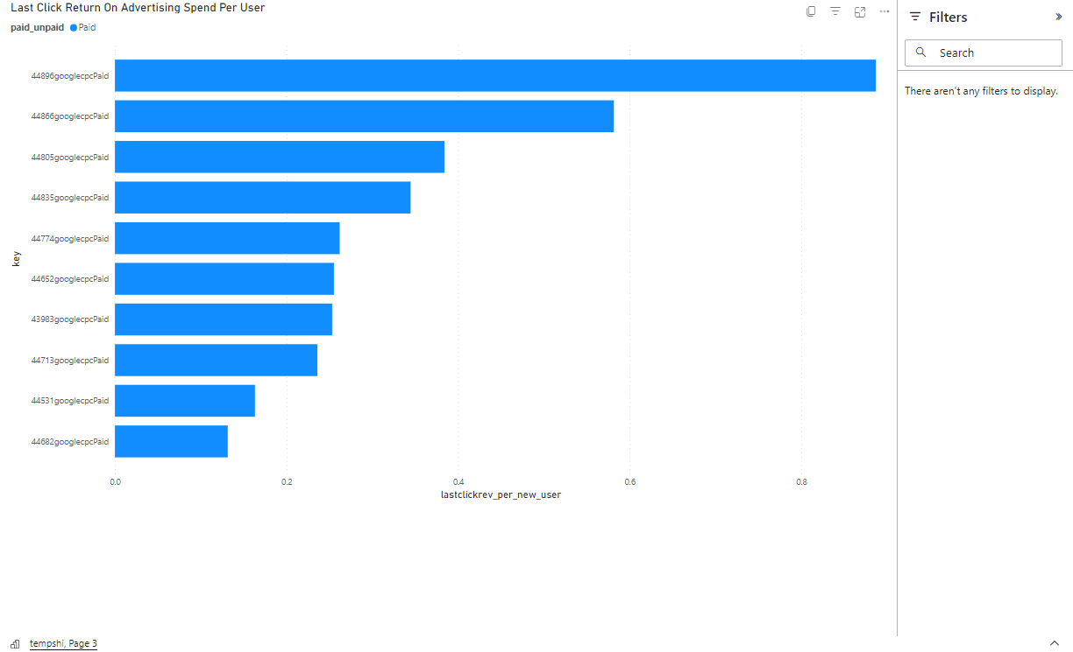
We are losing money on paid marketing cost
December 2022
November 2022
Taking the highest revenue paid source, Google CPC, at most we make 89p per user brought in.
Google CPC costs between 0.50p and £5.00.
September 2022
Notes:
continued paid marketing spend as a strategy to get new customers doesn't have good long-term prospects. the most we have got back from Google CPC ads across all years is 89p using last-click attribution and 86p using first-click. Regardless with CPC costs beings anything between .5p and £5 we are likely loosing money on Google cpc and other paid marketing. For long term profitability and stability, transitioning money to more unpaid channels would be recommended.
Ad return per user per month ONLY Google CPC. Most of our paid advertising comes from Google CPC.
Dec 2022 made the most 89p. (Last click)
Recommendation: Reallocate the marketing budget to the unpaid and organic channels
Impact: Up to £4 saved per user on acquisition costs going forward.

Slide 7
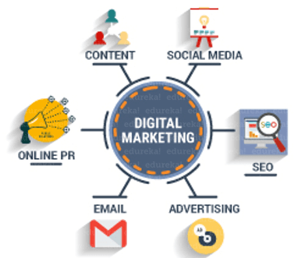
OWNED/FREE vs. NOT OWNED MEDIA
Owned/Free Media:Media:
crm (Customer Relationship Management) - email, push, system mail, sms
organic social (Prism's social media) - Facebook, Instagram, Twitter, Tiktok, YouTube
Not Owned Media:
cpc
cpm
cpv
none
organic
referral
affiliate
influencer
comparison
N

Slide 8
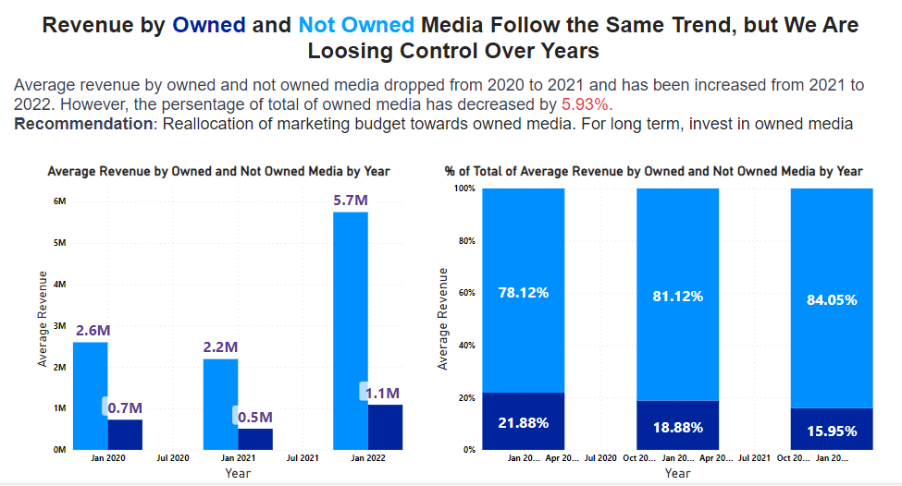
Revenue by Owned/Free and Not Owned Media Follow the Same Trend but We Are Losing Control
Average revenue by owned and not owned media dropped from 2020 to 2021 and has increased from 2021 to 2022. However, the percentage of total of owned media has decreased by 5.9%.
Recommendations: Reallocation of marketing budget towards owned media. For long term, invest in own media.

Slide 9




Recommendations for Prism

Slide 10
We should invest in owned media for long term success
Losing control of owned media
Long term we are losing money on paid marketing cost per user
Recommendations:
Reallocation of marketing budget towards owned media, pull marketing
For long term, invest in own media.
Impact: Reduce costs, increases profits.
20.6% decrease between last and first-click
Recommendation: Reallocate the marketing budget to the unpaid and organic channels
Impact: Up to £4 saved per user on acquisition costs going forward.
Recommendation: Further analysis on how changing attribution models affects customer segments
Impact: Informed decision on attribution changes.

Slide 11
Questions?

Slide 12
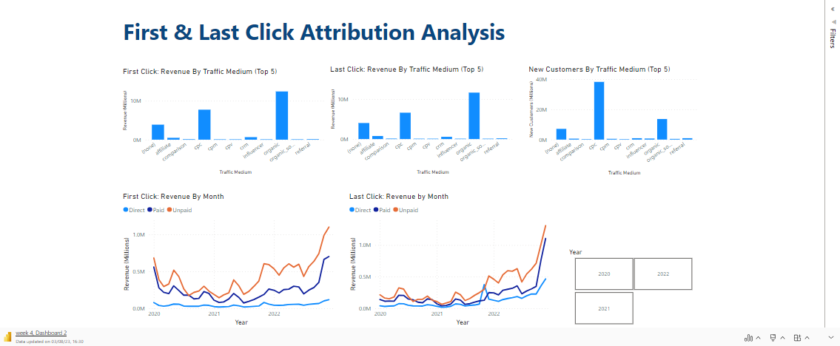
Dashboard

